Slide 1
PageRank: Part 2
Adjusted Model

Slide 2
Adjusted Random Walk

Slide 3
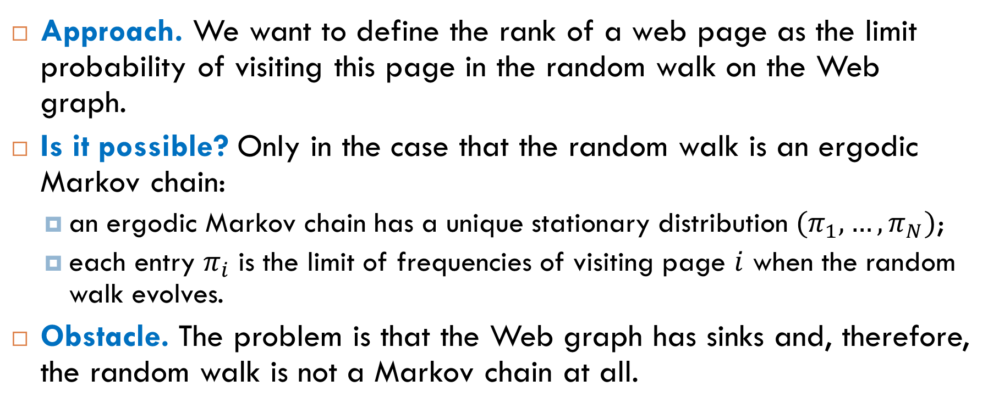
Ranks as Stationary Probabilities
Approach. We want to define the rank of a web page as the limit probability of visiting this page in the random walk on the Web graph.
Is it possible? Only in the case that the random walk is an ergodic Markov chain:
an ergodic Markov chain has a unique stationary distribution $(π_{1}, …, π_{N})$;
each entry $π_{i}$ is the limit of frequencies of visiting page $i$ when the random walk evolves.
Obstacle. The problem is that the Web graph has sinks and, therefore, the random walk is not a Markov chain at all.

Slide 4
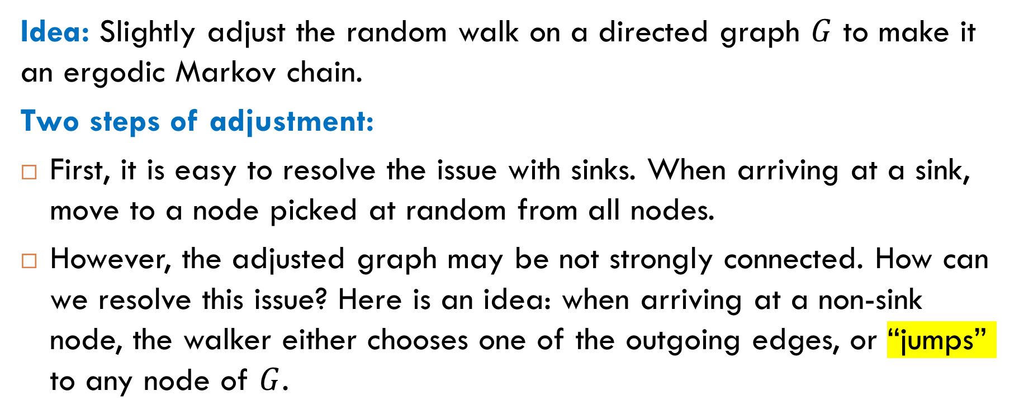
Google’s Idea: Adjusted Random Walk
Idea: Slightly adjust the random walk on a directed graph $G$ to make it an ergodic Markov chain.
Two steps of adjustment:
First, it is easy to resolve the issue with sinks. When arriving at a sink, move to a node picked at random from all nodes.
However, the adjusted graph may be not strongly connected. How can we resolve this issue? Here is an idea: when arriving at a non-sink node, the walker either chooses one of the outgoing edges, or “jumps” to any node of $G$.

Slide 5
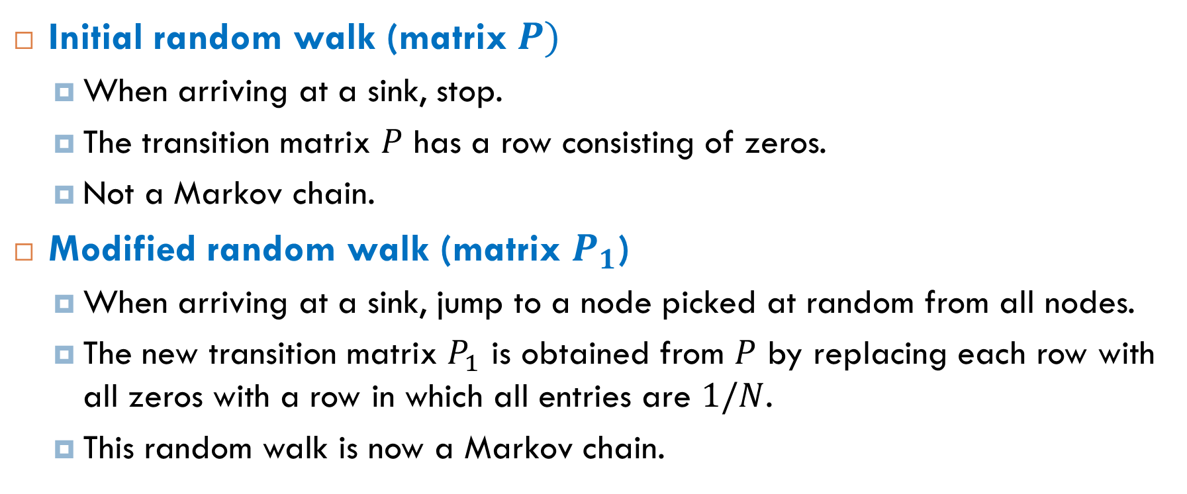

First Step of Adjustment: From $P$ to $P_{1}$
Initial random walk (matrix $P)$
When arriving at a sink, stop.
The transition matrix $P$ has a row consisting of zeros.
Not a Markov chain.
Modified random walk (matrix $P_{1}$)
When arriving at a sink, jump to a node picked at random from all nodes.
The new transition matrix $P_{1}$ is obtained from $P$ by replacing each row with all zeros with a row in which all entries are $1/N$.
This random walk is now a Markov chain.

Slide 6
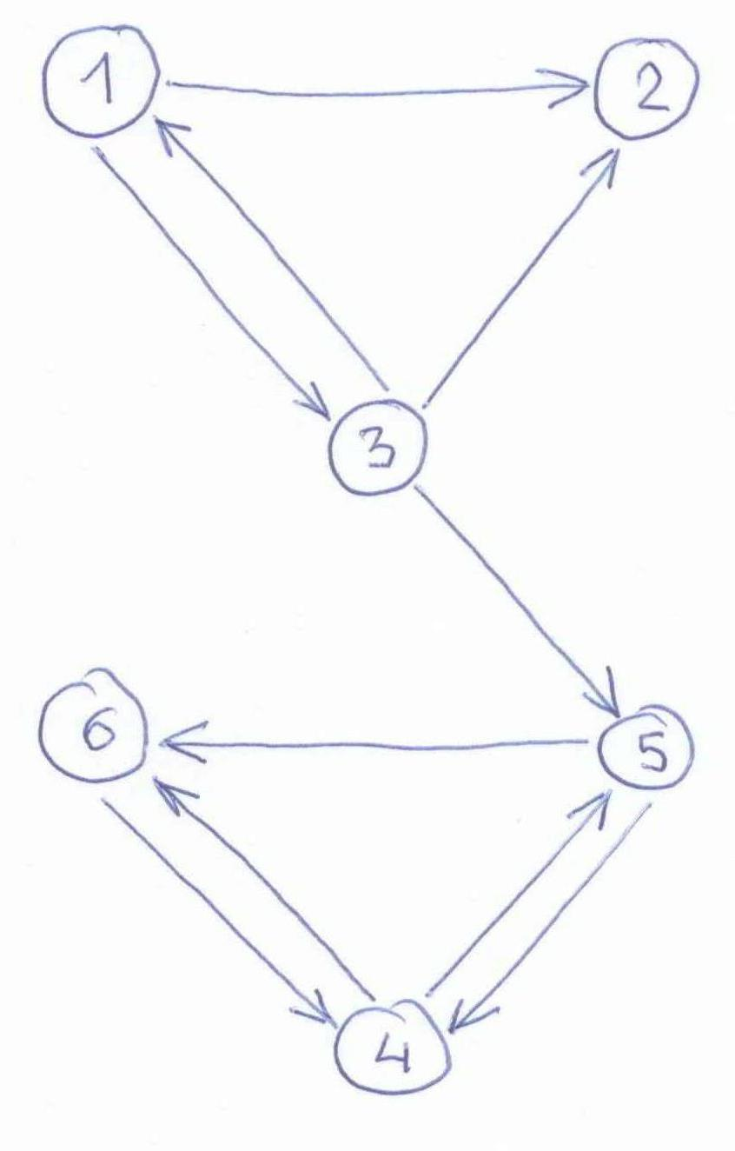
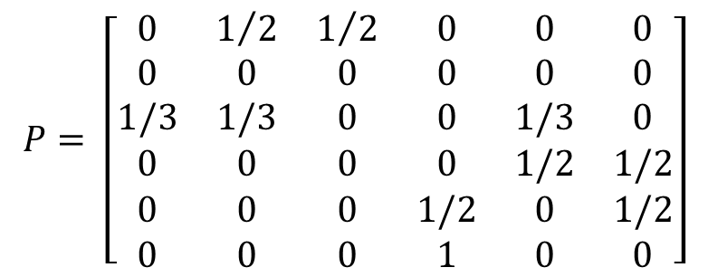
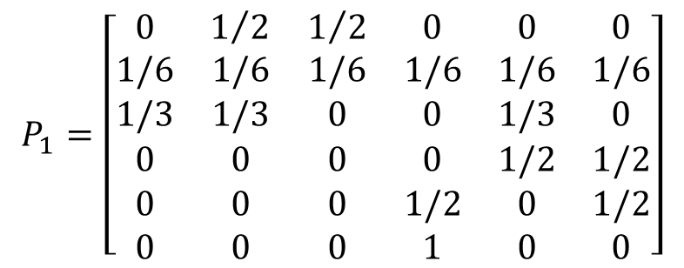
Example
$$P= \left[\begin{matrix}0 & 1/2 & 1/2 & 0 & 0 & 0 \\ 0 & 0 & 0 & 0 & 0 & 0 \\ 1/3 & 1/3 & 0 & 0 & 1/3 & 0 \\ 0 & 0 & 0 & 0 & 1/2 & 1/2 \\ 0 & 0 & 0 & 1/2 & 0 & 1/2 \\ 0 & 0 & 0 & 1 & 0 & 0\end{matrix}\right]$$
$$P_{1}=\left[\begin{matrix}0 & 1/2 & 1/2 & 0 & 0 & 0 \\ 1/6 & 1/6 & 1/6 & 1/6 & 1/6 & 1/6 \\ 1/3 & 1/3 & 0 & 0 & 1/3 & 0 \\ 0 & 0 & 0 & 0 & 1/2 & 1/2 \\ 0 & 0 & 0 & 1/2 & 0 & 1/2 \\ 0 & 0 & 0 & 1 & 0 & 0\end{matrix}\right]$$

Slide 7
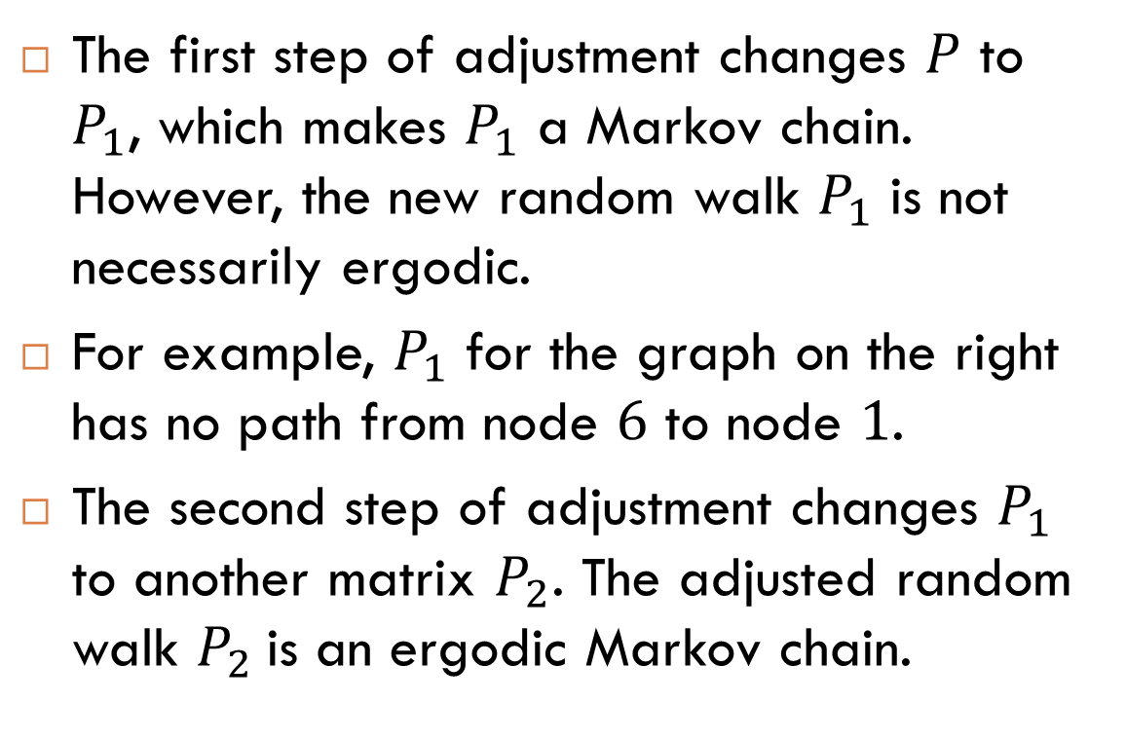
More Adjustment Is Needed
The first step of adjustment changes $P$ to $P_{1}$, which makes $P_{1}$ a Markov chain. However, the new random walk $P_{1}$ is not necessarily ergodic.
For example, $P_{1}$ for the graph on the right has no path from node $6$ to node $1$.
The second step of adjustment changes $P_{1}$ to another matrix $P_{2}$. The adjusted random walk $P_{2}$is an ergodic Markov chain.

Slide 8
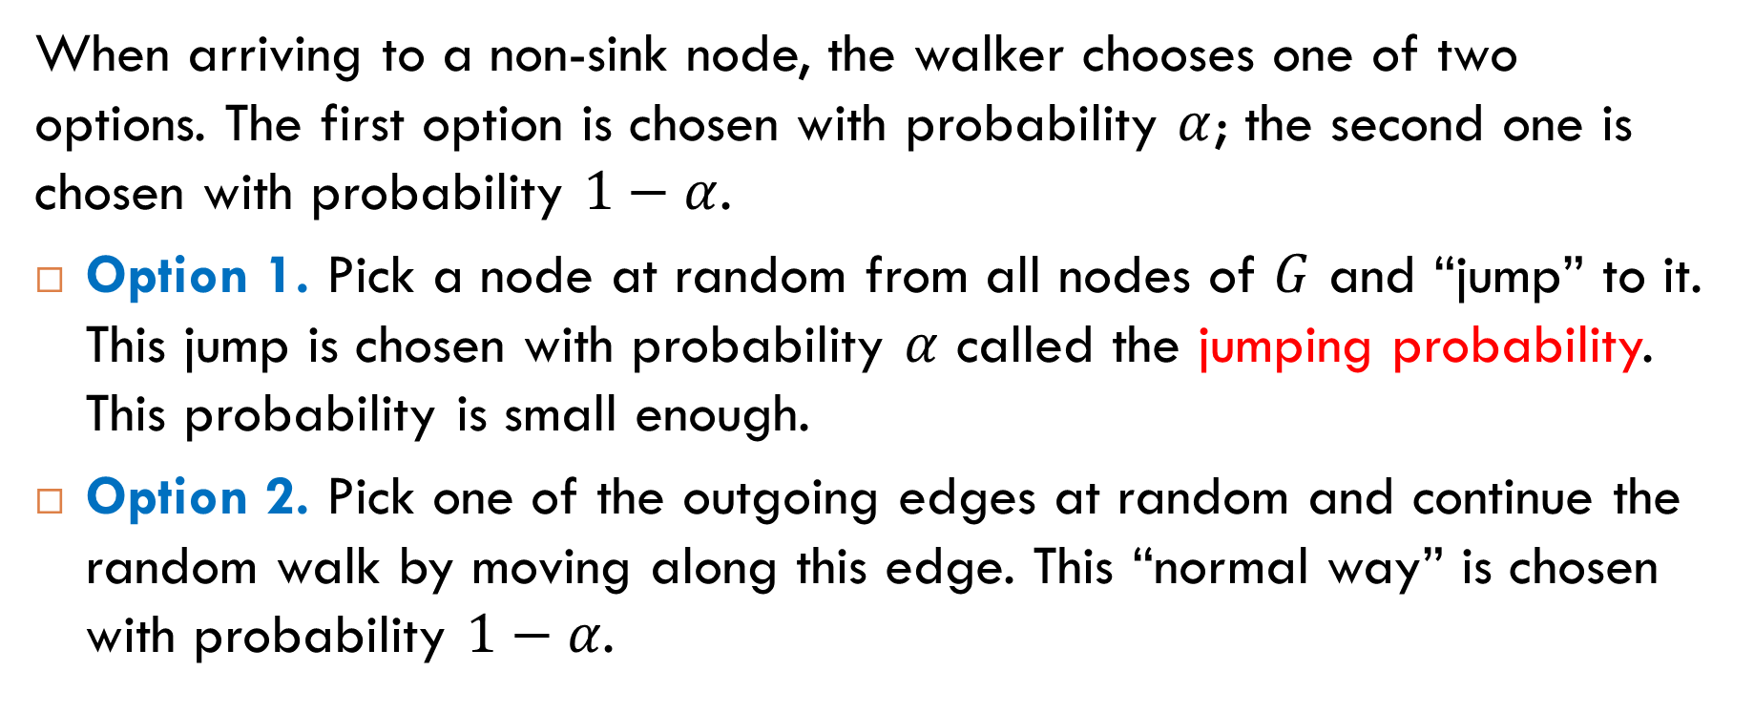
Second Step of Adjustment
When arriving to a non-sink node, the walker chooses one of two options. The first option is chosen with probability $α$; the second one is chosen with probability $1−α$.
Option 1. Pick a node at random from all nodes of $G$ and “jump” to it. This jump is chosen with probability $α$ called the jumping probability. This probability is small enough.
Option 2. Pick one of the outgoing edges at random and continue the random walk by moving along this edge. This “normal way” is chosen with probability $1−α$.

Slide 9



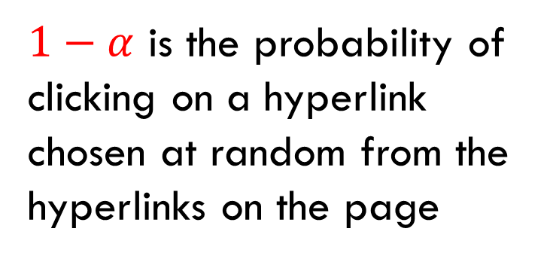

Second Step of Adjustment: From $P_{1}$ to $P_{2}$
Input: Matrix $P_{1}=\left[x_{ij}\right]$ and jumping probability $α$.
Output: Matrix $P_{2}=\left[y_{ij}\right]$ where
$$y_{ij}=\left(1−α\right)⋅x_{ij}+α⋅(1/N)$$
$1−α$ is the probability of clicking on a hyperlink chosen at random from the hyperlinks on the page
$α$ is the probability of jumping to a page picked from all pages at random

Slide 10



Second Step of Adjustment in Matrix Form
The adjusted matrix $P_{2}$ is obtained from the matrix $P_{1}$:
Here $E_{N}$ is the $N×N$ matrix where all entries are $1/N$:
$$P_{2}=\left(1−α\right)P_{1}+αE_{N}$$
$$E_{N}=\left[\begin{matrix}1/N & ⋯ & 1/N \\ ⋮ & ⋱ & ⋮ \\ 1/N & ⋯ & 1/N\end{matrix}\right]$$

Slide 11

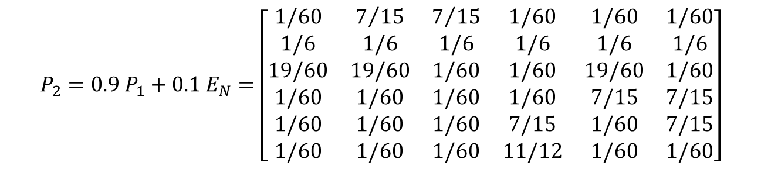
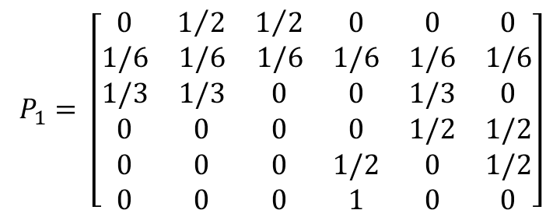
Example: From $P_{1}$ to $P_{2}$ with $α=0.1$
$$P_{1}= \left[\begin{matrix}0 & 1/2 & 1/2 & 0 & 0 & 0 \\ 1/6 & 1/6 & 1/6 & 1/6 & 1/6 & 1/6 \\ 1/3 & 1/3 & 0 & 0 & 1/3 & 0 \\ 0 & 0 & 0 & 0 & 1/2 & 1/2 \\ 0 & 0 & 0 & 1/2 & 0 & 1/2 \\ 0 & 0 & 0 & 1 & 0 & 0\end{matrix}\right]$$
$$P_{2}=0.9{ P}_{1}+0.1 E_{N}=\left[\begin{matrix}1/60 & 7/{15} & 7/{15} & 1/60 & 1/60 & 1/60 \\ 1/6 & 1/6 & 1/6 & 1/6 & 1/6 & 1/6 \\ 19/60 & 19/60 & 1/60 & 1/60 & 19/60 & 1/60 \\ 1/60 & 1/60 & 1/60 & 1/60 & 7/15 & 7/15 \\ 1/60 & 1/60 & 1/60 & 7/15 & 1/60 & 7/15 \\ 1/60 & 1/60 & 1/60 & 11/12 & 1/60 & 1/60\end{matrix}\right]$$

Slide 12
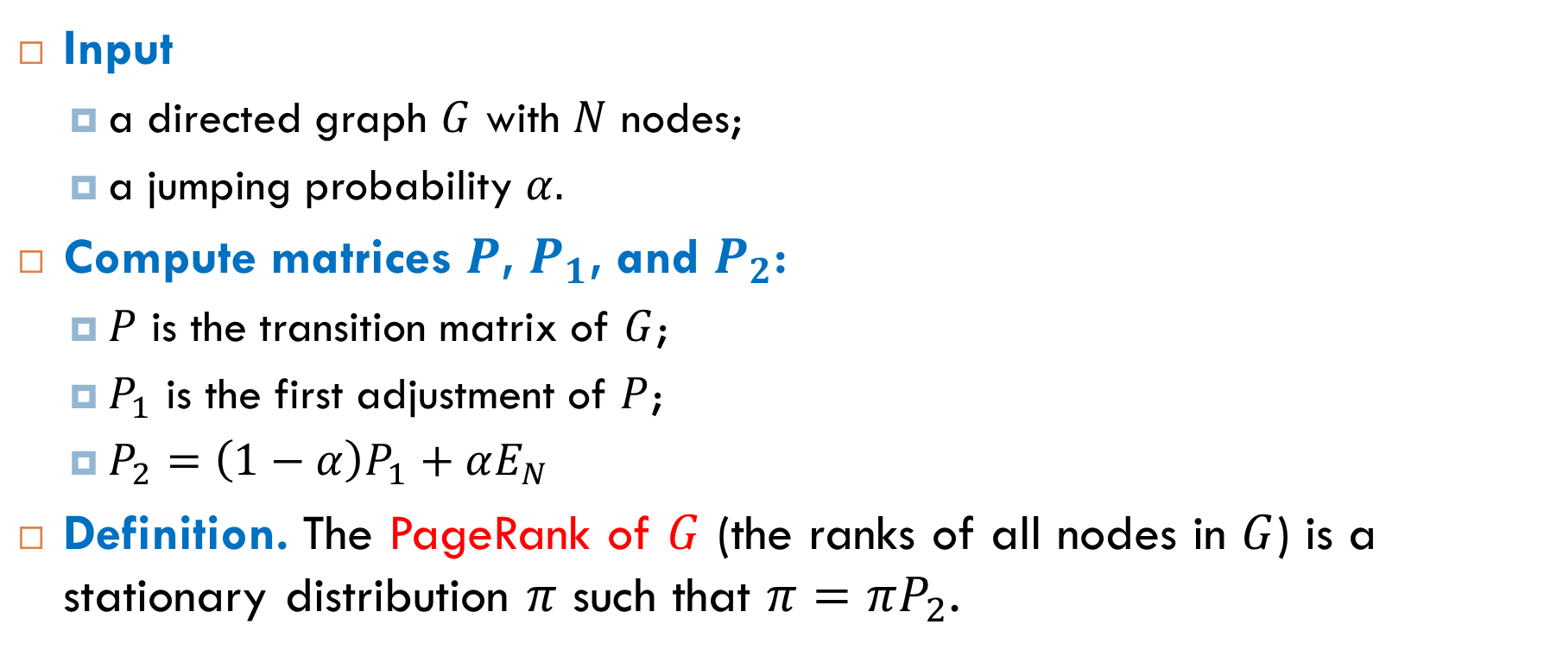
Definition of PageRank
Input
a directed graph $G$ with $N$ nodes;
a jumping probability $α.$
Compute matrices $P$, $P_{1}$, and $P_{2}$:
$P$ is the transition matrix of $G$;
$P_{1}$ is the first adjustment of $P$;
$P_{2}=\left(1−α\right)P_{1}+αE_{N}$
Definition. The PageRank of $G$ (the ranks of all nodes in $G$) is a stationary distribution $π$ such that $π=πP_{2}$.

Slide 13
Computing PageRank

Slide 14
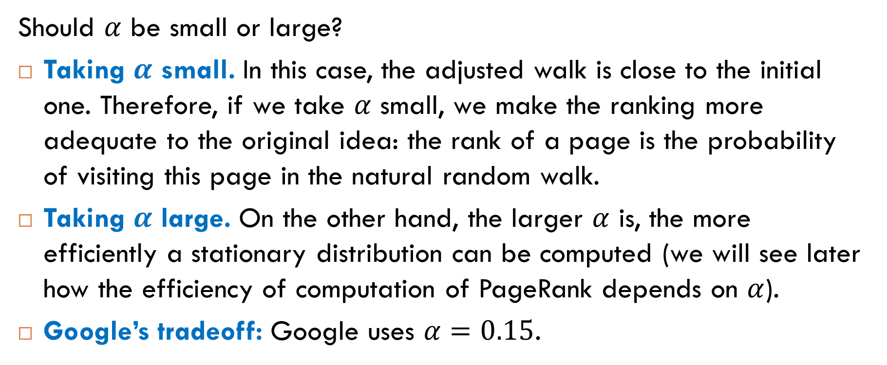
Jumping Probability
Should $α$ be small or large?
Taking $α$ small. In this case, the adjusted walk is close to the initial one. Therefore, if we take $α$ small, we make the ranking more adequate to the original idea: the rank of a page is the probability of visiting this page in the natural random walk.
Taking $α$ large. On the other hand, the larger $α$ is, the more efficiently a stationary distribution can be computed (we will see later how the efficiency of computation of PageRank depends on $α$).
Google’s tradeoff: Google uses $α=0.15$.

Slide 15
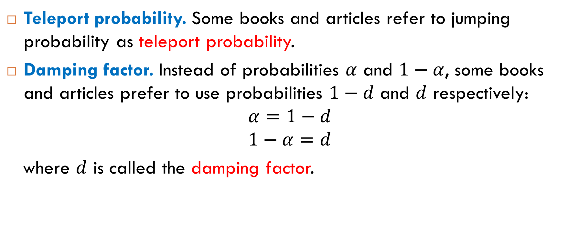
Jumping Probability: Note on Terminology
Teleport probability. Some books and articles refer to jumping probability as teleport probability.
Damping factor. Instead of probabilities $α$ and $1−α$, some books and articles prefer to use probabilities $1−d$ and $d$ respectively:
$$α=1−d$$
$$1−α=d$$
where $d$ is called the damping factor.

Slide 16


How to Compute PageRank?
By definition, the PageRank of $G$ is a stationary distribution vector of the matrix equation $π=πP_{2}$. We can find it by solving the corresponding system of linear equations:
$$p_{11}π_{1}+p_{21}π_{2}+…p_{N1}π_{N}=π_{1}$$
$$p_{12}π_{1}+p_{22}π_{2}+…p_{N2}π_{N}=π_{2}$$
$$⋮$$
$$p_{1N}π_{1}+p_{2N}π_{2}+…p_{NN}π_{N}=π_{N}$$
$$π_{1}+π_{2}+…+π_{N}=1$$
requirement for distribution vectors

Slide 17

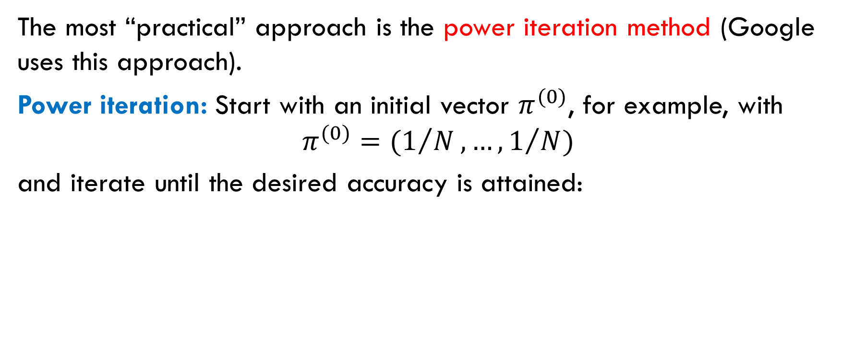
The Power Iteration Method
The most “practical” approach is the power iteration method (Google uses this approach).
Power iteration: Start with an initial vector $π^{(0)}$, for example, with
$$π^{(0)}=(1/N, …, 1/N)$$
and iterate until the desired accuracy is attained:
$$π^{(1)}=π^{(0)}P_{2}$$
$$π^{(2)}=π^{(1)}P_{2}$$
$$⋮$$
$$π^{(k)}=π^{(k−1)}P_{2}$$

Slide 18
Google’s Implementation
Special techniques
Special algorithms for working with small numbers.
Special algorithms for sparse matrices.
Special algorithms to avoid total re-computation of the stationary vector.
Google’s initial distribution. Instead of the uniform distribution, Google uses its own initial distribution. The choice of an distribution affects neither mathematical nor computational aspects, but it allows Google to (slightly) manipulate ranks.

Slide 19
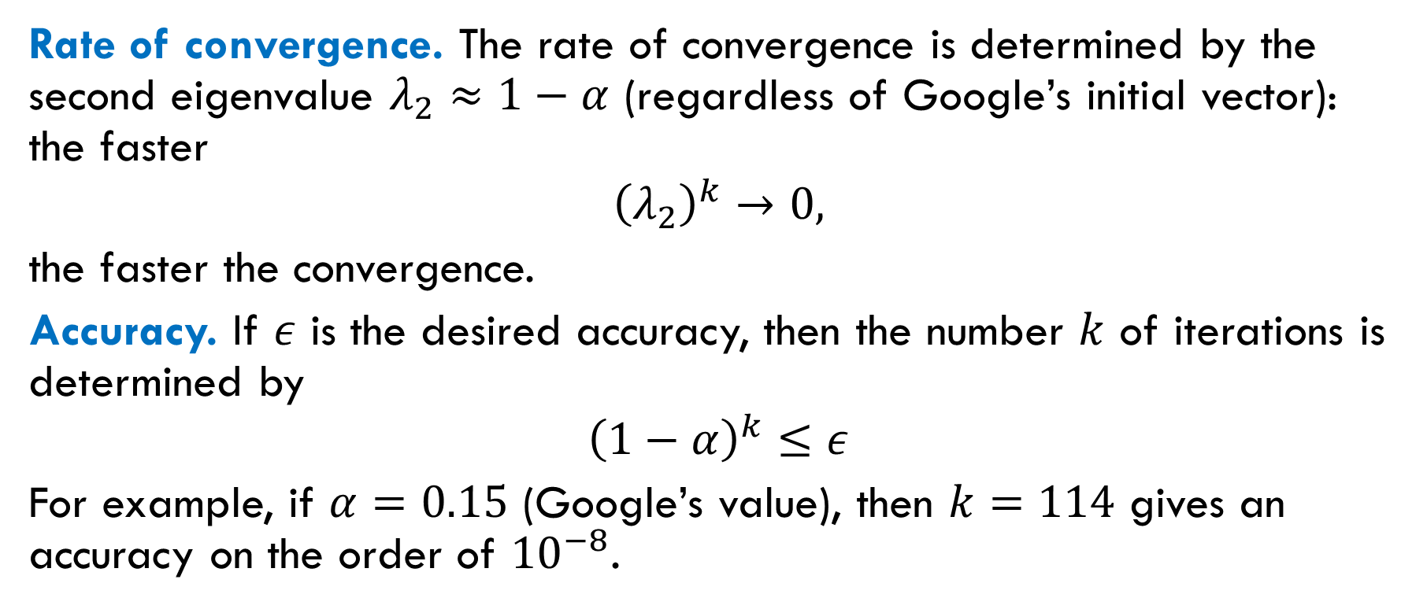
Convergence
Rate of convergence. The rate of convergence is determined by the second eigenvalue $λ_{2}≈1−α$ (regardless of Google’s initial vector): the faster
$${\left(λ_{2}\right)}^{k}→0,$$
the faster the convergence.
Accuracy. If $ε$ is the desired accuracy, then the number $k$ of iterations is determined by
$${\left(1−α\right)}^{k}≤ε$$
For example, if $α=0.15$ (Google’s value), then $k=114$ gives an accuracy on the order of ${10}^{−8}$.

Slide 20



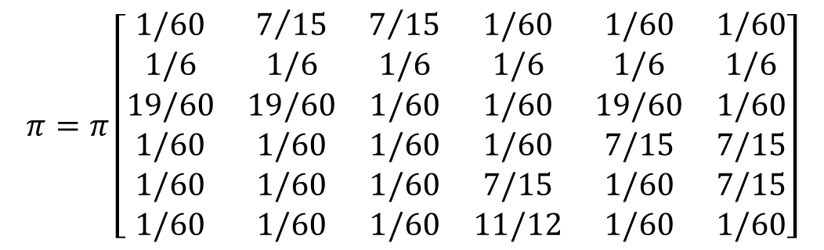
Example of PageRank
Matrix equation ($α=0.1)$:
Solution:
$$π=π\left[\begin{matrix}1/60 & 7/{15} & 7/{15} & 1/60 & 1/60 & 1/60 \\ 1/6 & 1/6 & 1/6 & 1/6 & 1/6 & 1/6 \\ 19/60 & 19/60 & 1/60 & 1/60 & 19/60 & 1/60 \\ 1/60 & 1/60 & 1/60 & 1/60 & 7/15 & 7/15 \\ 1/60 & 1/60 & 1/60 & 7/15 & 1/60 & 7/15 \\ 1/60 & 1/60 & 1/60 & 11/12 & 1/60 & 1/60\end{matrix}\right]$$
$$π_{1}=0.0372$$
$$π_{2}=0.0540$$
$$π_{3}=0.0415$$
$$π_{4}=0.3751$$
$$π_{5}=0.2060$$
$$π_{6}=0.2862$$

Slide 21
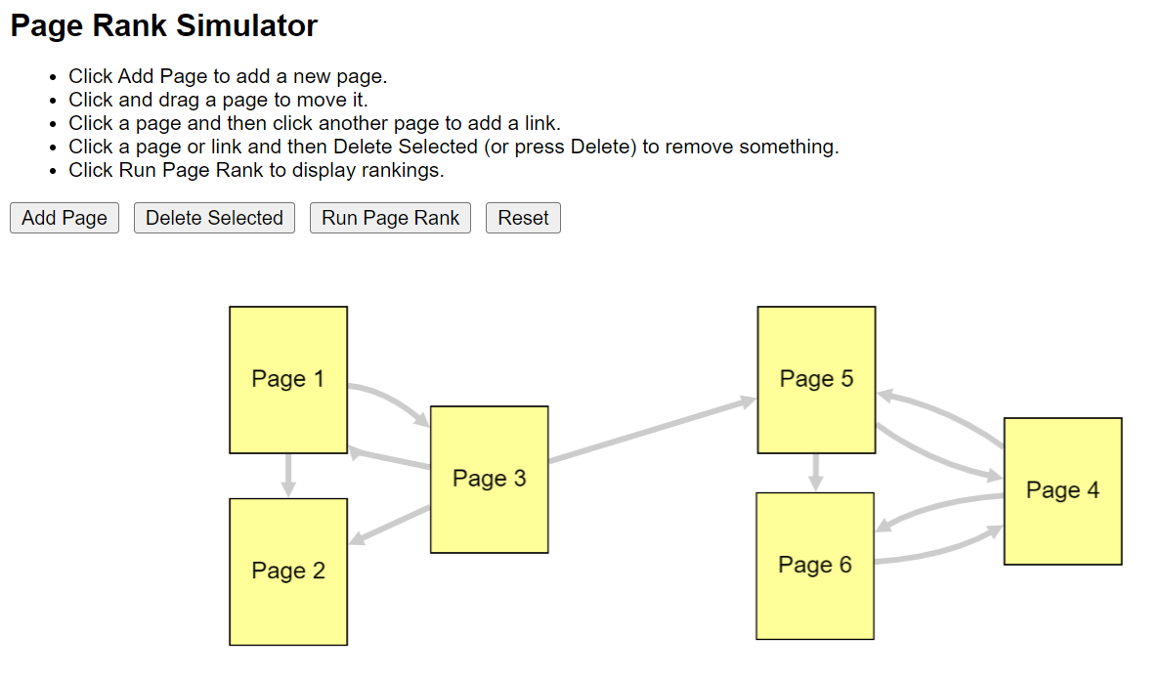
Online PageRank Calculator

Slide 22
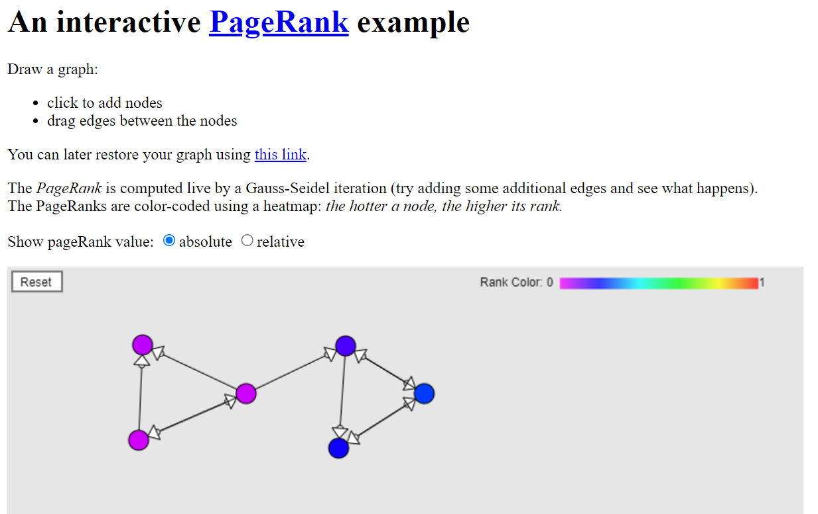
Another Online PageRank Calculator

Slide 23

Reading
Section 7.1.4

